Slide 1
Working Patterns Implementation Toolkit
February 2022

Slide 2
Working Patterns Case Studies
Based on a project involving all UKFRS to research and record working patterns
Resulted in the delivery of working pattern case studies, details about provision across all services and international comparators
50 Services have provided a SPOC (inc all British Isles)
44 provided policy documentation including duty systems and collective agreements
9 case studies have been written
1 Case Study Implementation Tool

Slide 3
Working Patterns in Figures

Slide 4
Firefighter totals
 |  | WT | OC | Totals | WT | OC
2020 | England | 22,793 | 12,498 | 35,291 | 65% | 35%
2019 | Scotland | 3,636 | 2,937 | 6,573 | 55% | 45%
2019/20 | Wales | 1,453 | 1,753 | 3206 | 45% | 55%
2020 | NI | 822 | 907 | 1,729 | 48% | 52%
 | UK | 28,704 | 18,095 | 46,799 | 61% | 39%
Figures from Devolved Administrations and Home Office
Headcount figures, not FTE
Requested wholetime/on-call from SPOCs

Slide 5
Fire Station totals
 |  | WT | OC | Mixed | WT | OC | Mixed
2020 | England | 425 | 734 | 236 | 30% | 53% | 17%
2019 | Scotland | 50 | 283 | 23 | 14% | 79% | 6%
2018/19 | Wales | 32 | 108 | 9 | 21% | 72% | 6%
2020 | NI | 7 | 46 | 7 | 10% | 68% | 10%
 | UK | 514 | 1171 | 275 | 26% | 59% | 14%
Figures from Devolved Administrations and Home Office
Mixed stations are combined WT/OC or DC/OC

Slide 6
Working Patterns data
Dual contracts (wholetime / on-call staff) | %
Dual contract staff as % of sample workforce | 6
Dual contract staff as % of wholetime | 11
Dual contract staff as % of on-call | 13
Met. services: LFB, GMFRS and WMFS removed from sample
Based on responses from 44 Service SPOCs with 28 providing data
Home Office and Devolved Administrations figures for underlying headcount figures
Dual contracts of 28 services providing data | %
Dual contract staff as % of sample workforce | 10
Dual contract staff as % of wholetime | 23
Dual contract staff as % of on-call | 17
Service policies indicate 36 services with dual contract staff
Second table breaks down dual contracting for the 28 services, which provided data

Slide 7
Wholetime totals
Wholetime Working Patterns
Total Wholetime Sample | 48
Total Services with a Wholetime 2-2-4 pattern | 43
Total Services with Wholetime/On-call staff(Dual Contracts) | 36
Total Services with joint crewing (WT/OC on one watch)* | 11
* For example, on-call staff providing overtime, resilience cover on wholetime watches to cover wholetime staff shortages

Slide 8
Variation on 2-2-4 Patterns
2-2-4 day hours | Sub total
09:00 -18:00 | 15
07:00 -19:00 | 4
08:00 -18:00 | 4
08:00 -19:00 | 4
08:00 -20:00 | 2
07:00 -18:00 | 1
07:30 -18:00 | 1
07:30 -18:30 | 1
07:30 -19:30 | 1
08:00 -17:00 | 1
08:00 -18:00 (m-f), 08:00-16:00 (w/e) | 1
08:15 -18:15 | 1
08:30 -18:30 | 1
08:30 -19:00 | 1
08:30 -20:30 | 1
09:00 -19:30 | 1
09:30 -20:00 | 1
Grand Total | 41

Slide 9
Variation on 120 hour on-call contracts
120 variations | Sub total
<120 or >120 | 4
120-90 | 4
<120-120-100-80-40-50 | 1
100-85-70 | 1
105 94.5-84-73.5-63-52.5-42-31.5 | 1
110-100-90-80-70-60-50 | 1
120-xx-36 | 1
120-100-80 | 1
120-108-96-90-84-72-60-48 | 1
120-70-35 | 1
120-80-40 | 1
120-84 | 1
120-90- <90 | 1
120-90-64 | 1
120-90-74 | 1
120-sliding scale-40 | 1
120-xx-30 | 1
120-xx-50 | 1
xx-84-50-30 | 1
42 | 1
Unknown | 1
Grand Total | 27

Slide 10
Variation on Day Crewing Patterns
Day Patterns per service | Sub total
Unknown / tbc | 4
1 | 17
2 | 10
3 | 1
Grand total | 31
31 of the services have one or more stations on a day crewing pattern
10 Services have more that one day crewing patterns across the establishments
1 service has 3 different patterns

Slide 11
Variation on Day Crewing Patterns
Day Patterns per service | Sub total
Total day crewing and OC evenings | 23
Total day crewing including weekends | 16
Total day crewing 4 on 4 off 2 watch system | 10
Total weekday plus / self rostered patterns | 9
Total day crewing 2 on, 2 off, 3 on, 2 off, 3 on two week rota | 6
Total 9 day fortnight (4d on 3 off, 5 on 2 off etc) | 6
Total 24 hour rotations (PH and standby) | 4
Total day crewing 3 on 3 off 2 watches | 4
Total day crewing 4 days then 5th day every 4 weeks | 3
Total 7 day fortnight | 1
Some services use several of these patterns refined for specific stations depending on local need
Some services have wholetime staff working weekends at some stations but weekly crewing at others

Slide 12
Variation on Day Crewing Patterns
Core Hours (inc PH and FH) | Sub total
08:00-20:00 | 4
08:00-17:00 | 3
07:00-19:00 | 3
08:00-18:00 | 3
08:00-19:00 | 2
07:00-19:00(3/3) / 09:00-21:00w,10:00-17:00we(4/4) | 1
07:30-19:30 / 07:00-19:00 | 1
07:00-19:00 / 08:00-18:30 t-f | 1
07:00-18:00 | 1
08:00-18:30 | 1
07:30-18:30 | 1
08:00-18:00 / 08:00-20:00 | 1
07:00-19:00 / 08:00-20:00 | 1
06:00-18:00 | 1
08:30-18:00 / 07:30-18:00 | 1
09:00-17:00 | 1
08:30-20:30 | 1
08:30-18:30 | 1
08:00-17:20 / 07:00-19:00 | 1
Grand Total | 29
These working patterns include some services including a period of positive hours or flex-time
Some services have a range of patterns depending on local needs
Some services include different hours on different days of the week
Services with multiple patterns grouped together

Slide 13
Working Patterns Case Studies

Slide 14
Innovative Working Patterns – 9 Case Studies
Innovation | Description | Example Services
Ridership | Impact on adjusting establishment levels on staffing and costs | Kent, Cumbria
2. Remote Resource and Virtual Crews | Watches deployed from HQ or a virtual station to meet gaps across establishments | West Yorks, South Yorks, West Sussex, Oxford
3. Optimum on-call contracts | Moving from traditional 120 to be more demand led | Humberside, H&W
4. Dual Station | Crews or managers who straddle more that one station depending on time of day | Cumbria, Essex
5. Pay for Availability | Alternative incentives | Devon and Somerset
6. Day Crewing + | Explanation of pros and cons of this model
7. Variations on 2-2-4 | Alternatives and changes such as increased rota days | Scotland, West Sussex
8. Delayed Turnout | Second pumps not rolling as first response vehicles | Merseyside
9. Flexible Mobilising | Various smaller innovations | Surrey, Gloucestershire, Lincs

Slide 15
Working Pattern Implementation Tool

Slide 16
Working Pattern Implementation Tool
Developed to accompany case studies
Designed in consultation:
Working Patterns Project Board
On-Call Practitioners Group
Service Single Points of Contact (Working Patterns SPOCS)
NFCC People Engagement Forum
Individual Services testing with project teams and staff

Slide 17
Working Pattern Implementation Tool
Used to measure existing working patterns or a new pattern to provide measurable and transparent comparative indicators
The toolkit could:
Support a service to measure completely new ideas for a working pattern against an existing set of criteria, developed by the NFCC Working Patterns Project or
Support services to measure existing working patterns in operation in one or more service and see how these patterns may relate to their staff, communities and organisation.

Slide 18
Working Pattern Implementation Tool
The tool has six pillars to compare one working pattern with another:
Competency
Efficiency and Effectiveness
Equality, Diversity and Inclusion
Safety
Well-being
Community Impact
There is a scoring mechanism to provide a means to weigh the comparative scores of each pillar against the others.
There are 16 measurable criteria cross referenced to relevant pillars

Slide 19
Working Pattern Implementation Tool
Measurable criteria:
Availability of the appliance can be maintained within IRMP requirements and community need
Combined training between duty systems, locations, drill nights is accommodated
Control of the working pattern over and above legal requirement
Data drives staffing requirements to adjust crew availability based on skills and community risk profiles
Facilitates positive working environment through movement of staff between watches and duty systems
Individual staff are not pressurised to maintain availability levels
Scheduling accounts for commuting challenges when staff are rostered to different locations per shift
Staff have control of their hours and availability to fit around personal commitments and work life balance
Staff have time to pursue CPD and training opportunities
Staff in multiple roles have adequate rest
The prevent and protect needs of the community are met by maintaining adequate staffing
The working pattern accommodates and engages with a safety first culture
The working pattern is resilient to changing political and staffing factors
There are adequate rest periods for staff
There are opportunities to support work outside of the role map
There is opportunity for ongoing engagement with local communities

Slide 20
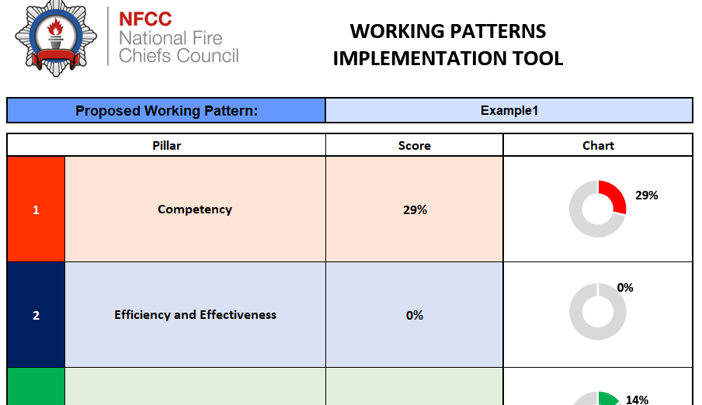
Working PatternImplementation Tool
Using the tool
1. Put the name of the working pattern here
2. Discuss each pillar in turn and consider whether the working pattern under discussion achieves the criteria Y or N, specifically for that pillar.
In this example, does the working pattern meet a Competency requirement to support combined training between duty systems, locations and drill nights?

Slide 21
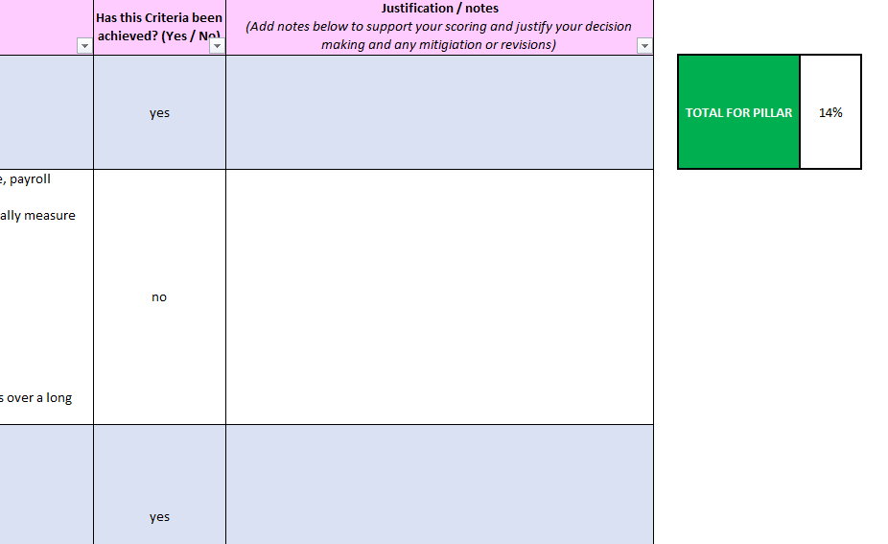
Working Pattern Implementation Tool
Using the tool
3. Each Y adds 1 to the score, each N subtracts 1
4. You may want to write notes to accompany your analysis

Slide 22
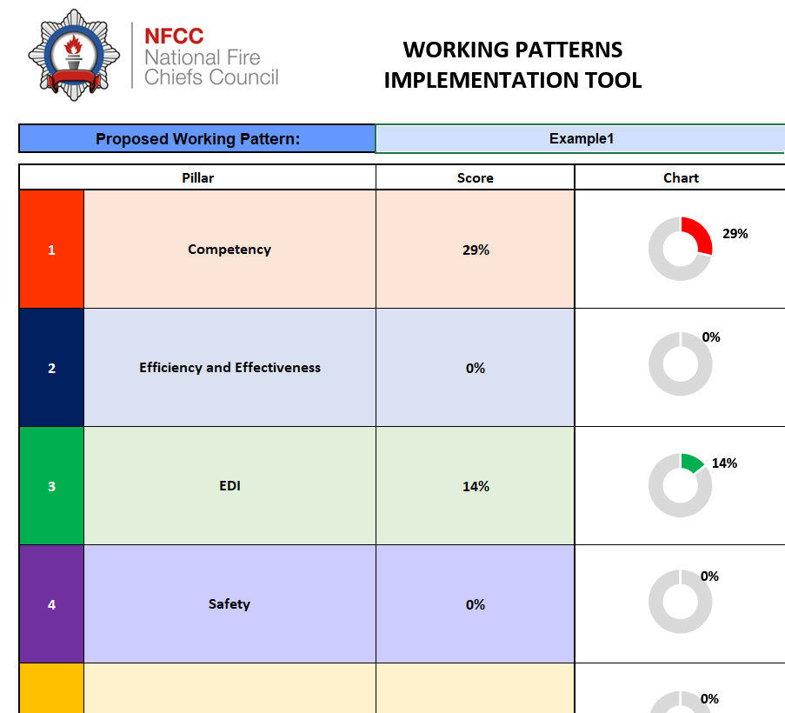
Working Pattern Implementation Tool
Using the tool
5. When the analysis is complete you will have an evaluation score to use for comparisons between working patterns and pillars providing quantitative and qualitative measures

Slide 23
Working Patterns

