Slide 1
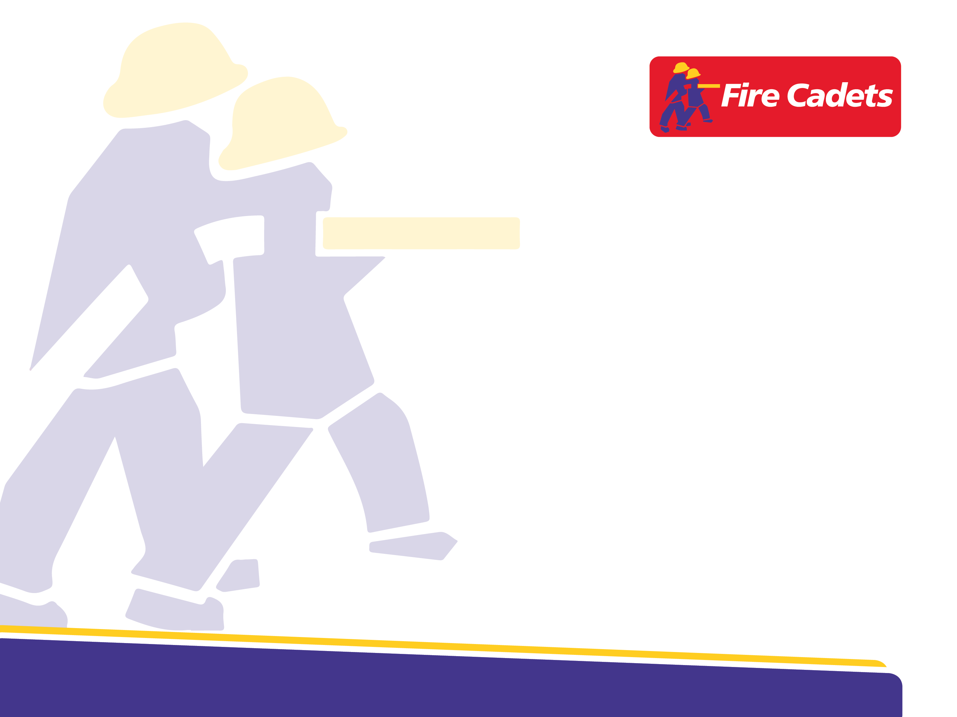
UK Fire Cadets
Fire Cadet Drill Ground Supervision Course

Slide 2
Introduction
The purpose of this course is to provide fire and rescue services with guidance on training staff and volunteers to deliver and supervise fire service youth drills (YH1-4 and YL1-3) with young people.
The content herein aligns with the NFCC’s Fire and Rescue Service Manual: Youth Drill Ground Training and Development, which sets out standard practices, techniques and scenario-based training for young people in the fire and rescue service.
This course was created by a working group of individuals from across UK fire and rescue services, with representation from 17 fire and rescue services across all nations.
Notes:
Acknowledgements (2025)
This course was created by a working group of staff from FRSs and NFCC, with thanks to:
Aileen Wilson (Essex County FRS)
Allan Young (NFCC)
Amy Jenkins (South Wales FRS)
Arron Kite (Derbyshire FRS)
Clair Victory (South Yorkshire FRS)
David Shortt (Northern Ireland FRS)
David Ward (West Midlands FS)
Ed Harvey (Northamptonshire FRS)
Emma Biffi (West Sussex FRS)
Gary Williams (NFCC)
Gemma McDonough (Lancashire FRS)
Gerry Davis (Merseyside FRS)
Graham Harmour (West Sussex FRS)
Holly Willis (County Durham & Darlington FRS)
JP Charlton (Kent FRS)
Julie Rea (Northern Ireland FRS)
Karen Mayze (Mid and West Wales FRS)
Natasha Neale (Nottinghamshire FRS)
Nicholas Cooper (Greater Manchester FRS)
Norman Rees (South Wales FRS)
Mark Bennett (Lincolnshire FRS)
Michelle Bates (Northamptonshire FRS)
Rachel Hughes (Derbyshire FRS)
Ruth Cairns (Scottish FRS)
Sarah Gustafson (London FB)
Stephen Gallagher (South Wales FRS)
Wayne Burney (Kent FRS)

Slide 3
Course content
Creating a safe and supportive learning environment
Intro to teaching Fire Cadets practical knowledge and skills
Health and Safety on the drill ground
Squad Formation including numbering off and falling in
Effective detailing/briefing of drills
Maintaining effective control during drills
Effective debriefing of drills
Participating in and supervising YH1-4 and YL1-3 standard drills

Slide 4
Section 1
Creating a safe and supportive learning environment

Slide 5
Objectives
Outline the challenges faced by young people
Determine how to create a code of conduct
Discuss our role in creating a positive environment

Slide 6
What personal challenges or issues might our young people be facing?
Group activity

Slide 7
Issues affecting young people
Mental health
Social media
School bullying
Body image
Poverty
Depression
Family problems
Adverse Childhood Experiences
Substance/alcohol abuse
Educational inequality
Housing
Health
Peer pressure
Anxiety
Violence
Special Educational Needs and Disabilities / Additional Support Needs
Notes:
Please Note: It is noted that the term Special Educational Needs may not be used by all organisations, however it remains the terminology used by UK Government so is used throughout this document.
Ref: https://www.gov.uk/government/publications/send-code-of-practice-0-to-25

Slide 8
Maslow’s Hierarchy of Needs
Self-actualisation
Desire to become the most that one can be
Esteem
Respect, self-esteem, status, recognition, strength, freedom
Love and belonging
Friendship, intimacy, family, sense of connection
Safety needs
Personal security, employment, resources, health, property
Physiological needs
Air, water, food, shelter, sleep, clothing, reproduction
Notes:
How can your Fire Cadet programme facilitate this?
Physiological needs – without these basic needs, young people cannot focus on other aspects of their development.
Safety needs – a predictable environment with a sense of security will allow a young person to feel comfortable.
Love and belonging – forging relationships and being part of a group will allow young people to engage in activities where they feel appreciated.
Esteem – building on their own esteem and gaining recognition from others can improve confidence and develop a positive self image.
Self – actualisation – once a young person reaches this level they will have a desire to fulfil their personal potential and realise their own accomplishments.

Slide 9
Maslow’s Hierarchy of Needs
Self-actualisation (desire to become the most that one can be)
Esteem (respect, self-esteem, status, recognition, strength, freedom)
Love and belonging (friendship, intimacy, family, sense of connection)
Safety needs (personal security, employment, resources, health, property)
Physiological needs (air, water, food, shelter, sleep, clothing, reproduction)

Slide 10

Institute for Youth Work - Code of Ethics
We have a duty of care to young people. In the youth work relationship, the best interests of young people have priority.​
We do not seek to advance ourselves, our organisations, or others– personally, politically, or professionally – at the expense of young people.​
Our relationship with young people remains within professional boundaries at all times, to protect the young person and the purpose of the work.​
We work in a fair and inclusive way, promoting justice and equality of opportunity, challenging any discriminatory or oppressive behaviour or practice.
Notes:
Note: As Fire Cadets is a uniformed youth organisation, a youth work code of ethics has been incorporated into this content. This content should not detract from individual Fire and Rescue Service code of ethics and FRS Values which should also be adhered to; however, it is recognised these may be covered within other induction trainings.

Slide 11
Institute for Youth Work - Code of Ethics
We seek to enhance young people’s personal and social development by:
  - Enabling them to make informed decisions and pursue their choices;
  - Supporting their participation and active involvement in society;
  Helping them to become independent and move on when the time is right.
We promote the welfare and safety of young people, while permitting them to learn through undertaking challenging educational activities. We avoid exposing young people to the likelihood of harm or injury. This includes implementing safeguarding policies and procedures.
When we receive or collect personal information about young people, we make them aware of with whom and for what purpose that information will be shared. We do not disclose confidential information unless this is necessary to prevent harm or is legally required.
In our engagement with young people, and in our resulting relationship, we strive to be honest and non-judgemental.
Notes:
Note: As Fire Cadets is a uniformed youth organisation, a youth work code of ethics has been incorporated into this content. This content should not detract from individual Fire and Rescue Service code of ethics and FRS Values which should also be adhered to; however, it is recognised these may be covered within other induction trainings.

Slide 12
Institute for Youth Work - Code of Ethics
We respect the contribution of others concerned with the welfare and well-being of young people and will work in partnership to secure the best outcomes for young people.
We encourage ethical reflection and debate with colleagues, managers, employers and young people.
We make sure we have the knowledge and skills necessary to work effectively with young people. We work in a reflective way to develop our abilities. We take account of the impact of work on ourselves.
We maintain consciousness of our own values, beliefs and interests, are aware when these conflict with those of others, and approach difference respectfully.
Institute for Youth Work – Code of Ethics
Notes:
Note: As Fire Cadets is a uniformed youth organisation, a youth work code of ethics has been incorporated into this content. This content should not detract from individual Fire and Rescue Service code of ethics and FRS Values which should also be adhered to; however, it is recognised these may be covered within other induction trainings.

Slide 13

Code of conduct / Group agreement
Mutually agreed
Justified
Framed positively
On display at all times
For example:
Keep phones on silent
Listen to others
Be open minded
Be non-judgemental
Use respectful language
Respect the premises
Respect differences
Take part
Ask for help
Notes:
The first step in creating a safe and supportive learning environment is to ensure that an agreed code of conduct is in place. This could be named “Cadet Values” or a “Code of conduct”
The values should be framed in a positive way e.g. do show respect by listening.
They should also be created by both Cadets and instructors.
If a particular value is included that raises disputes from Cadets, discuss reasons why it must be included e.g. for their own safety etc.
The more the young people are involved in creating their values, the more likely they are to buy into them.

Slide 14

Safe and supported
A warm welcome
Pro-social modelling
Growth mindset
Openness
Judgement free
Reminder of Fire Cadets values
Notes:
For some young people, schools, colleges and extra curricular activities (such as Cadets) may be the only places they feel safe.
Our aim is to help them build their confidence to enable them to be able to contribute positively to society.
During their time with us, we must demonstrate what that look likes and we can do this by consistently being positive role models.
Question ?How can we be positive role models?
We can actively provide praise and model a growth mind-set to include admitting to our own mistakes and demonstrating willingness to learn.
Creating a judgement free zone, mistakes are made without ridicule or harsh punishment but rather seen as a learning experience.
If behaviours are starting to slip, remind young people of their Fire Cadets values but remember that works both ways.

Slide 15
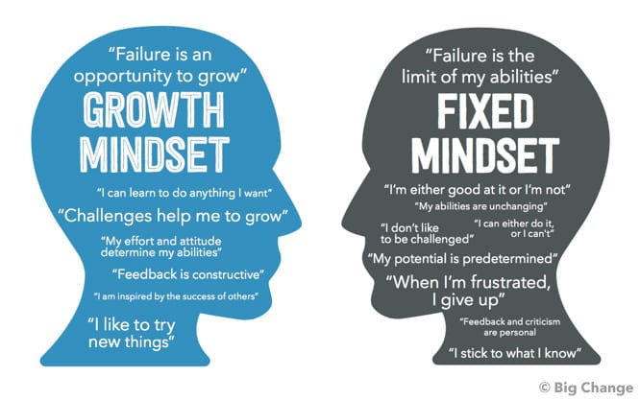
Mindset
Growth mindset
“Failure is an opportunity to grow”
“I can learn to do anything I want”
Challenges help me to grow”
“My effort and attitude determine my abilities”
“Feedback is constructive”
“I am inspired by the success of others”
“I like to try new things”
Notes:
Some of your Cadets may demonstrate a fixed mind-set. Here are some examples of fixed vs growth.

Slide 16
Mindset
Fixed mindset
“Failure is the limit of my abilities”
“I’m either good at it or I’m not”
“My abilities are unchanging”
“I don’t like to be challenged”
“I can either do it, or I can’t”
“My potential is predetermined”
“When I’m frustrated, I give up”
“Feedback and criticism are personal”
“I stick to what I know”
Notes:
Some of your Cadets may demonstrate a fixed mind-set. Here are some examples of fixed vs growth.

Slide 17
Looking at the following examples, work together to change the statements from fixed to growth
Group activity

Slide 18
Change from fixed to growth
"I'm just not good at it, so there's no point in trying."
"I've always been bad at fitness, so I'll never be able to do it."
"I'm not smart enough to understand this."
"I've made it, I know everything there is to know."
"There's no point in trying if I'm going to fail."
"I take feedback as a personal attack."
"I feel threatened/intimidated when others are doing well."
"I can't learn now; it's too late."
Notes:
"I'm not good at it yet, but I can learn and improve with practice."
"I'm not naturally great at fitness, but I can learn techniques and improve with practice."
"I'm not sure I understand this yet, but I can work at it and learn."
"I always have more to learn."
"Everyone makes mistakes, and these mistakes are an opportunity to succeed the next time."
"I can learn from my mistakes and adjust my strategies."
"I can learn and practice those skills until I feel capable."
"I'm not good at something yet, but I can learn and improve with effort and practice."
"I can embrace challenges and see them as opportunities to learn and grow."
"I can learn from feedback and use it to improve."
"I can persevere in the face of setbacks."
"I can actively seek out learning opportunities."
"I can adapt to change."

Slide 19

Conflict Resolution / De-escalation Strategies
T.H.I.N.K technique
Is it true?
Is it helpful?
Is it inspiring?
Is it necessary
Is it kind?
Tiffany Nguyen - Pinterest
Notes:
Discuss the above strategies in terms of making others feel safe in their environment.
The THINK technique is a framework used to enhance communication and emotional regulation, particularly in conflict situations, by encouraging thoughtful responses.
– T = Is it TRUE (Is it based on fact or opinion?)​
– H = Is it HELPFUL (Will your words help you, others or the situation?) ​
– I = Is it INSPIRING (Does it promote honest AND respectful dialogue?) ​
– N = Is it NECESSARY (Would this be better left unsaid?) ​
– K = Is it KIND (What is your motivation for communicating?)

Slide 20
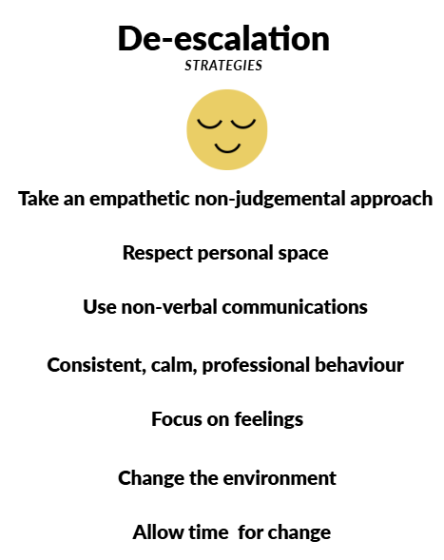
Conflict Resolution / De-escalation Strategies
De-escalation strategies
Take an empathetic, non-judgemental approach
Respect personal space
Use non-verbal communications
Consistent, calm, professional behaviour
Focus on feelings
Change the environment
Allow time for change
Notes:
Discuss the above strategies in terms of making others feel safe in their environment.
Image by Clair Victory (South Yorkshire FRS)

Slide 21
Group activity
Challenging scenarios
Notes:
Work through the scenarios in your groups.
https://padlet.com/CListerVictory/challenging-scenarios-aydmlx0sxeyt6tsm

Slide 22
During a wet hose run, Lenny decides to spray water all over the rest of the group and instructors.
Scenario 1

Slide 23
You have just introduced the next activity which is going to be a drill outside. Billy says they don’t want to do it.
Scenario 2

Slide 24
Tommy comes to cadets, you say hello and he ignores you. You ask him to put his phone away and he tells you to f*** off.
Scenario 3

Slide 25
Cara and Jonny were on the drill yard. They started pushing each other around and then it turned into a fist fight.
Scenario 4

Slide 26
Natalie comes to cadets withdrawn. She tells you that her mum and boyfriend had an argument, and he hit her.
Scenario 5

Slide 27
Tyler keeps coming to cadets 20-30 minutes late with no prior notification.
Scenario 6

Slide 28
Section 2
Health and safety on the drill ground

Slide 29
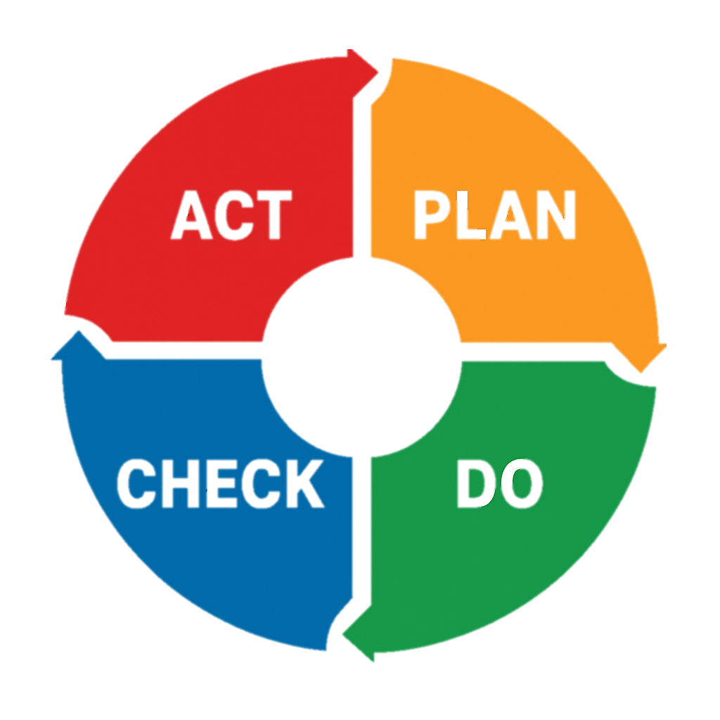

Introduction to health, safety and wellbeing
Purpose
To ensure cadet instructors maintain the highest standards of safety and safeguarding when delivering a Fire Cadets session.
Safe Cadets, Safe Staff, Safe Service
Key priorities:
Protect cadets and staff
Minimise risk
Create a safe, inclusive learning environment
Ensure that all Fire Cadet instructors/Leads are utilising and familiarising themselves with NFCC’s Fire and Rescue Service Manual: Youth Drill Ground Training and Development (Pages 26 to 48)
Notes:
Plan, Do, Check, Act cycle depicts the iterative approach we should take to health and safety.
We plan, through risk assessment and identifying control measures.
We do, by implementing control measures.
We check, by reviewing if the control measures are adequate and appropriate.
We act, by applying further control measures and feeding these into the next planning cycle.

Slide 30
Drill ground safety: core principles
Adhere to fire and rescue service Youth Drill Ground associated risk assessments for drill ground practices and classroom-based activities
Adhere to individual cadets’ risk assessments
Always complete a dynamic risk assessment
Remove any hazards and clear obstructions during pre-checks
Ensure suitable PPE is provided and worn at all times
Keep clear safe working zones (cones, barriers, gateways, traffic management)
Establish clear communication signals (refer to NFCC Youth Drill Ground Manual)
Maintaining minimum supervisory ratios as guided by NFCC (1:5 drill ground, 1:10 classroom) – no Lone Working
Equipment testing as per service direction
PPE checks

Slide 31
Instructor responsibilities (Health and safety)
Arriving early and inspecting the drill ground for hazards (slips, trips, sharp objects, weather conditions)
Check all equipment is fit for use and meets safety criterion
Managing welfare, checking that all cadets and staff are fit to participate before and after activities
Clear safety brief before every activity
Maintain constant visual contact and employ dynamic risk assessment into practice throughout the activities
Cease activity immediately if unsafe and use of correct commands (“REST” by Instructor or “STILL” by anyone including Cadets)

Slide 32
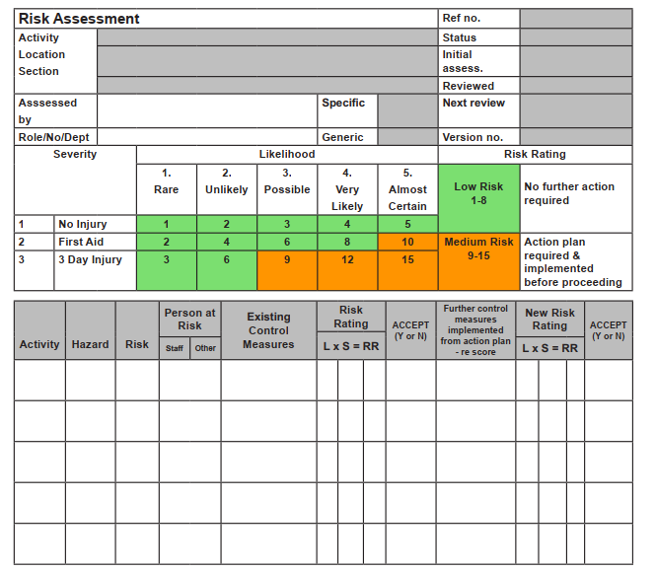
Risk assessment
Notes:
Image on screen shows Risk Assessment Template from NFCC Youth Drill Ground Manual.
The risk assessment includes:
Activity Title
Location of activity
Assessment date and review date
Who carried out the assessment and job title
A scoring matrix with likelihood from 1 (Rare) to 5 (Almost certain), and severity from 1 (No injury) to 3 (3 day injury)
Space for assessing each component, with details to be provided of Activity, Hazard, Risk, Who is at risk, Existing Control Measures, Risk Rating, Further Control Measures, New Risk Rating.
FRS will have risk assessments in place for youth drill ground activities.
Before carrying out drills, it is instructors' responsibility to be familiar with these, and to understand and implement control measures and accompanying safe systems of work.
Note: where fire cadet instructors are required to risk assess activities they should be provided with adequate training to allow this.

Slide 33
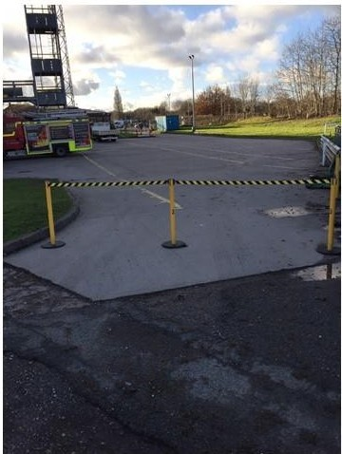
Drill ground/yard inspection
Underfoot conditions:
  Are there any holes or trip hazards, ice, glass, debris, etc. in the yard?
  If yes, can you clear hazards or can you drill in a different spot?
  Use cones to mark the area and make sure all cadets know about it.
Safe working zone:
  Coned off area of work or drill yard gates secured.
  Appropriate lighting/illumination of drill yard.
Is the tower safe to use?
  Have the lintels been checked?
  If the tower has lights, do they work?
Does the hydrant work properly?
  Can young people lift the lid easily?
  Does the lid fit back flat into the frame?
Notes:
Anything else?

Slide 34
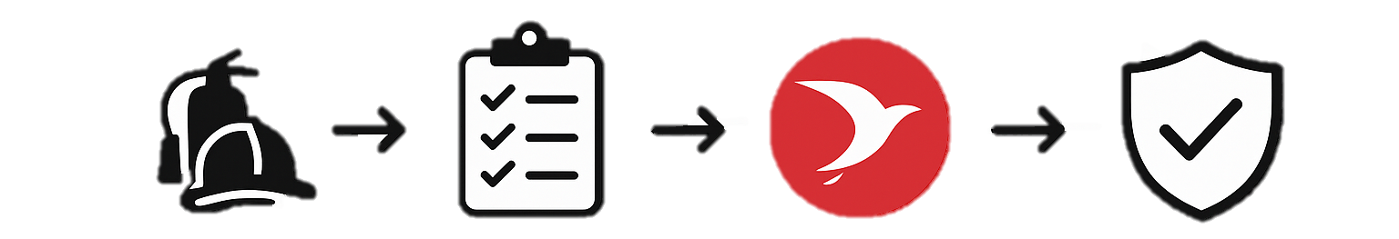
Equipment testing
Equipment
Standard Testing
Recording system, for example, Red Kite
Safe to use
Notes:
Equipment should be tested (including test recording) and maintained in line with local FRS policies and procedures.
Only equipment that has been tested in line with policies and procedures should be utilised within Fire Cadet drills.

Slide 35
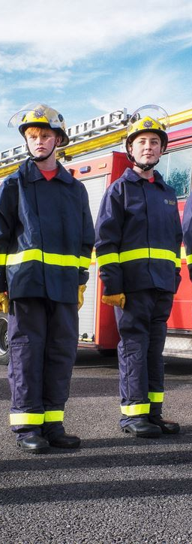
Personal protective equipment (PPE)
Helmet
Is it comfortable and does it stay in place? Does the chin strap fasten properly?
Tunic
Does it fit well and allow the arms to move freely?
Overtrousers/Leggings
Can the cadet squat down without them feeling too tight? Ensure leggings don’t extend under boots.
Boots
Are they the right size? Does the tread still provide good grip?
Gloves
Are there any splits or holes? Is the cuff still stretchy?
Hydration
Make sure cadets have full water bottles
Notes:
This slide should be adapted to contain the PPE of the relevant FRS.

Slide 36
Safety words of command
Command | Action or Meaning
Still | Used by anyone in an emergency i.e. to prevent an accident and then with maximum force; the young people remain perfectly still exactly where they are.
Rest | Used by the instructor when carrying out a standard practice to point out a mistake/teaching point; the young people remain still.
Well | To indicate that the position desired has been reached e.g. when extending or lowering a ladder.
Carry on | Given after ‘Rest’ or ‘Still’; the young people carry on with what they were doing.
Clear Behind | Given by either No.3 or No.4 when the ladder is due to be under run to let No.1 and No.2 know the area to be occupied when the ladder is under run is clear and they are safe to proceed.
Notes:
Taken from NFCC Youth Drill Ground Training and Development Manual.
Emphasise “Still” is for Safety Critical situations, whereas “Rest” is for non-safety critical situations and is to allow instructors to point out learning/correction.
Note: localisms may apply for each FRS and this content can be adapted to local application.

Slide 37

Manual handling
1. Assess – Stop and think
2. Feet – Position the feet
3. Adopt a good posture – knees, hips/back, head and neck
5. Load close – keep close to the load
6. Move the feet - don’t jerk
7. Adjust – put down then adjust
4. Grip – get a firm grip

Slide 38
Managing welfare
Ensure all participants have completed a Physical Activity Readiness Questionnaire
Pre-drill ground assessment via Q&A
Hydration breaks
Adaptation of drills suitable for individual needs (physical needs may need an individual risk assessment prior to course participation)
First aid provisions present at activity centres
Post drill ground activity assessment via Q&A

Slide 39
Accident / injury reporting (adapt to local procedure)
What to do in the event of an accident:
Report to Line Manager / Responsible Person as soon as reasonably practicable, giving as much information as possible.
The Line Manager / Responsible Person must immediately instigate any appropriate remedial action to prevent a recurrence.
The Line Manager / Responsible Person must, at the first opportunity (in any case within two hours of injury) notify Fire Control providing the basic factual information required in the Initial Injury Report Form H1(a).
Fire Control will complete Section 1 (Parts 1-5) of Form H1(a) and then inform the Health, Safety and Wellbeing Manager and/or the Duty Group Manager verbally as soon as reasonably practicable.
The Health, Safety and Wellbeing and/or the Duty Group Manager will then decide the level of investigation required.
Notes:
Slide to be adapted by Local FRS – example shown for South Wales FRS.

Slide 40
Near miss reporting (adapt to local procedure)
What is a ‘near miss’?
An occurrence that could have caused injury to a person or damage to property.
Why report a near miss?
Today’s near miss could be tomorrow's major injury. Reporting near misses can help us limit the harm or threat to an individual.
Reporting process
Notify line manager (Unit Manager or Fire Cadet Manager in absence of UM)
Line Manager / Unit Manager must, at the first opportunity (in any case within two hours of event) notify Fire Control, providing the basic factual information required in the Near Miss Report Form H4, or complete the online ‘Near Miss card’ which can be submitted direct to the Health, Safety and Wellbeing Team.
Notes:
Example shown for South Wales – edit to local process

Slide 41
Safeguarding: Core Principles
All Instructors to undertake a minimum of Level One Safeguarding Training
Always act in best interest of the cadet
Active listening skills
Do NOT ask leading questions
Ability to identify signs of neglect (for example, poor hygiene, tiredness, poor clothing, physical harm, sudden changes in mood)
Maintain professional boundaries
Avoid working alone and out of sight of other Fire Cadet Instructors/Leads
Report concerns immediately and never make promises to individual
Notes:
These slides should act as a reminder of Safeguarding training already completed prior to attending Drill Ground Supervision Course.

Slide 42
Safeguarding reporting process
Service
The service will do all it can to ensure that an adult’s and young person’s experience of our organisation is one that is free from exploitation or abuse.
All adults and young people have an equal right to protection from abuse or neglect regardless of their age, background, characteristics or vulnerabilities.
Individual
To ensure policies, procedures and practices are carried out to maintain safeguarding and the protection of others.
Determine when a safeguarding report is to be made/actioned.
Reporting to Line Manager and formally notify Fire Control to complete safeguarding referral.
Notes:
These slides should act as a reminder of Safeguarding training already completed prior to attending Drill Ground Supervision Course.

Slide 43
Section 3
Introduction to teaching Fire Cadets practical skills and knowledge
Notes:
This section introduces a basic approach to teaching practical/vocational skills and knowledge, as well as identifying techniques which can be used to provide feedback.
Fire Cadet Instructors should have developed basic Fire Cadet skills and knowledge as part of the pre-course requirements, and know be thinking how to teach these to Fire Cadets.

Slide 44
Teaching skills and knowledge
A simple framework to follow for teaching practical skills is the EDIP or EDICTS framework.
EDIP Framework:
Explain: Explain the main learning points of the skill you are about to demonstrate.
Demonstrate: Demonstrate the skill slowly, breaking it down into small chunks and highlighting the main learning points.
Imitate: Have the learner imitate the skill just demonstrated, reiterating the main learning points and providing feedback and encouragement.
Practice: Allow the learner to practice the skill, where possible observe to give feedback and encouragement.
Notes:
To insert pictures of the process in action with a fire cadet example, i.e. knot tying, hose running.

Slide 45
Teaching skills and knowledge
EDICTS Framework:
Explain: Explain the main learning points of the skill you are about to demonstrate.
Demonstrate: Demonstrate the skill slowly, breaking it down into small chunks and highlighting the main learning points.
Imitate: The learner should imitate the skill just demonstrated, whilst you reiterate the main learning points.
Correct: Provide feedback to the learner – what went well, what could be improved, and how to improve.
Try again: Allow the learner to try the skill again.
Summarise: Provide a summary of the main learning points and any specific areas which require practice, and highlight any progressions.

Slide 46
Providing feedback
There are two commonly utilised techniques for providing feedback in facilitation and teaching, ‘Sandwich’ feedback and ‘Medal and Mission’ feedback.
Sandwich Feedback Medal and Mission
Praise
Constructive criticism
Positive reinforcement
Goals
Mission
Medal
Medals – use these to recognise and provide positive feedback to participant/group about what they have done well.
Missions – use these to share areas for improvement with participant/group.
Goals – the medals and missions should relate to a clear goal for the participant/group.
Notes:
Sandwich Feedback:
Praise – begin feedback with a positive observation about the participant/group.
Constructive Criticism – follow with an area of improvement for the participant/group.
Positive Reinforcement – finish feedback with a reinforcement of the participant/group’s strengths and encourage them to improve.
Medal and Mission Feedback:
Medals – use these to recognise and provide positive feedback to participant/group about what they have done well.
Missions – use these to share areas for improvement with participant/group.
Goals – the medals and missions should relate to a clear goal for the participant/group.
Fire Cadet Example:
Goal – to be able to safely and effectively run out a length of Fire Cadet Hose
Medal may include “well done, you held the lugs correctly when running the hose out”
Mission may include “remember to lift the hose up high and in front of you to help not drag the coupling”

Slide 47
Teaching a skill - Practical
Candidates should now demonstrate instructing/teaching a Fire Cadet skill to participants.
Skill options:
Hose running
Hose coupling
Hydrant shipping and operation
Branch holding and operation
Notes:
Candidates to be assessed in line with EDIP/EDICTS framework and marked as:
Above required standard
Met required standard
Below required standard

Slide 48
Section 4
Effective detailing / Briefing and debriefing of drills

Slide 49
Briefing instructors
Assigning roles to instructors
At Cadets sessions, it is best practice to give instructors as much notice as possible as to what is happening so that they can best prepare for the drills.
This also gives opportunity for instructors to decide if they want to take on a role for the drill.
Ensure that the instructors are happy and any ideas from previous sessions to improve on a drill this is a chance for them to have input.
Purpose of the drill
The purpose of the drill must be made clear to everyone.
Having everyone on board for the drills makes it a better experience for everyone.
Making sure the drills are relevant to Fire Cadets. Use as best as possible real-life examples of firefighting to give cadets an understanding of what happens.
Notes:
Utilise Fire Cadet Manager (FCM) system to record and monitor

Slide 50
Outline the drill objectives
What equipment will be used?
Who is taking on what role?
How are the cadets going to achieve it?
Does the drill need adapting to suit specific needs and numbers?
Why this drill is important? Relate it to the world of firefighting.
Also consider if cadets will take on any leadership roles within drills, and brief appropriately.

Slide 51
Hazards
Make it clear to the other cadet instructors which hazards could arise during the drill.
For example:
Operational fire station
Hoses
Safety plans for the young people already in place – reminders
Safeguarding
Risk assessments
Injuries
PPE (fit for purpose and being worn)

Slide 52
Example for instructors
This session, we are doing YH1 drill with a crew of four Fire Cadets.
Instructor 1: Operational lead. You are overseeing everything from an operational perspective – including detailing the drill, briefing and debriefing the cadets, overall safety.
Instructor 2: Hydrant Safety Officer. You are overlooking the drill primarily at the hydrant.
Instructor 3: Branch Safety officer. You are overlooking the drill primarily at the branch.
Any additional instructors: Additional Safety Officers. You are overlooking the drill and dealing with cadets’ wellbeing, toilets, injuries etc.
Notes:
Highlight that where two crews are operating drills simultaneously, it is important that minimum 1:5 ratio is followed. Ratios may be more intensive dependant on drills and specific needs of YP

Slide 53
Briefing the Fire Cadets
State the objectives to the cadets (so they know what they are going to try and achieve).
Give the responsibility to the cadets. When you ask if they understand the drill, give them the reassurance and encouragement to speak up if they do not. If they do not understand the drill, then explain again.
Physical examples if needed. These are required if this a new skill or the young people are struggling to understand.
Remembering that there are breaks during the course, and that some cadets may need reminders of how to do things.
Allow the young people to run with the drill – give advice.
Ensure supervision and safety at all times.

Slide 54
Briefing the Fire Cadets
Depending on how far into the course you are, the drills will be broken down.
Closer to the end of the course, allow the drill to run from your first briefing. If things need changing or adapting for the second run of the drill, then a second briefing would take place.
Again, give the responsibility to the cadets. Ask them to feed back on how the drill went and what needs changing.
Purpose of the drill
The purpose of the drill must be made clear to everyone.
Having everyone on board for the drills makes it a better experience for everyone.
As the cadets progress make sure you relate the briefing/drill back to operational experience.

Slide 55
Debriefing the Fire Cadets
Check young people are fit and well, any injuries to report?
Relate the drill experience to the world of firefighting or personal development skills.
Ask the young people: what went well … what could be improved… what they enjoyed…
  This is also key because it helps the instructors plan/build on the drills for the next week.
Check that the young people are happy with their part in the drill, some may leave the evening upset/down about how their part in the drill went. But we want them to leave with confidence.

Slide 56
Debriefing the instructors
Check instructors are fit and well, any injuries to report?
Relate the drill to the world of fire fighting or personal development skills.
We ask the instructors: what went well … what could be improved… what they enjoyed…
  This is also key because it helps the instructors plan/build on the drills for the next week.
Ensure that the instructors are happy with their part in the drill.

Slide 57
Section 5
Maintaining effective control during drills
Notes:
Introduce the session by highlighting the purpose: developing essential skills for instructors to run safe and effective cadet drills. Explain that instructors serve as leaders, mentors, and safety officers simultaneously. Set the expectation: poor control undermines training, strong control ensures safety and professionalism.

Slide 58
Introduction
Why effective control matters
Effective control during fire cadet drills is the foundation of a safe environment. As an instructor you serve three critical roles simultaneously: leader, mentor, and safety officer.
Poor control can lead to injuries and bad habits, and undermines the discipline essential to emergency services. Strong control ensures cadets develop proper techniques while maintaining the safety standards expected on a drill yard.
Safety of cadets and instructors – preventing injuries during drills
Promotes discipline – building habits that cadets will follow
Efficient and realistic – maximising learning while ensuring training is appropriate for cadets
Notes:
Emphasize that effective control protects both cadets and instructors. Discuss how discipline and habits formed in training will carry into emergency response. Highlight the balance between efficiency and realism — we want maximum learning while keeping training appropriate for cadets’ abilities.

Slide 59
Key elements of effective control
Maintaining control of fire cadet drills requires coordinating multiple elements simultaneously. Each component reinforces the others to create a safe learning environment.
Positioning
Strategic placement to maximise visibility
Communication
Clear, consistent commands and feedback systems
Delegation
Effective use of instructors for maximum safety
Managing risk
Dynamic assessment and hazard mitigation
Situational awareness
Constant monitoring of conditions and cadets
Notes:
Introduce the five interconnected elements: positioning, communication, delegation, managing risk, and situational awareness. Stress that weakness in one area undermines the whole system of control.

Slide 60
Positioning
Your position during drills directly impacts your ability to maintain control. Effective positioning allows you to see all participants, intervene quickly, and demonstrate techniques clearly.
Establish a clear front - Position yourself where all cadets can see and hear you during briefings without distraction.
Move strategically - Circulate to monitor technique and safety without losing sight of the overall operation.
Use other instructors in hazard areas - Ensure instructors are placed at strategic positions (risk critical areas), with lines of sight maintained.
Don’t get consumed - Make sure you oversee the whole drill and don’t get consumed in one element.
Notes:
Explain how strategic positioning impacts visibility, authority, and safety. Establish a clear front when briefing cadets. Move strategically during drills to observe without losing oversight. Use instructors at hazard areas and avoid getting consumed by one element. Reinforce that your position communicates professionalism — cadets mirror your behaviour.

Slide 61
Communication
Clear communication is your primary tool for maintaining control. Effective instructors use multiple communication methods to ensure understanding.
Use clear, simple commands
Avoid complex instructions during drills. Use standard fire service terminology consistently. Commands should be loud enough for all participants to hear over equipment noise.
Demonstrate and explain
Show proper technique before expecting cadets to understand. Visual demonstration reinforces verbal instruction and accommodates different learning styles.
Notes:
Stress that clear, consistent communication is the instructor’s primary tool. Use simple commands and standard fire service terminology. Always demonstrate techniques before expecting cadets to perform. Check understanding by asking questions and watching non-verbal cues. Develop and use consistent hand signals and eye contact systems for noisy environments.

Slide 62
Communication
Check understanding
Ask specific questions to confirm understanding. Look for non-verbal cues indicating confusion or uncertainty before proceeding.
Master non-verbal signals
use consistent hand signals and eye contact systems. These become critical when verbal communication is compromised by noise or distance.
Notes:
Stress that clear, consistent communication is the instructor’s primary tool. Use simple commands and standard fire service terminology. Always demonstrate techniques before expecting cadets to perform. Check understanding by asking questions and watching non-verbal cues. Develop and use consistent hand signals and eye contact systems for noisy environments.

Slide 63
Delegation
Effective delegation multiplies your ability to maintain control while developing the skills of less experienced instructors. Proper delegation requires clear role definition and ongoing oversight.
Assign specific roles - Designate instructors as safety officers for high-risk areas and activities. Ensure each person understands their exact responsibilities.
Empower team leaders - Give instructors authority to manage small groups during drills. This develops their leadership while allowing you to focus on overall coordination.
Delegate safety checks - Assign instructors to conduct PPE inspections, equipment checks, and dynamic risk assessments before each drill.
Remember that delegation does not mean avoidance. You remain ultimately responsible for all training activities and must maintain oversight of delegated tasks.
Notes:
Review the three core commands: 'Still' — immediate stop of all activity. 'Rest' — maintain current position. 'Carry on' — resume or continue activity. Emphasize that consistency prevents confusion and maintains discipline.

Slide 64
Managing risk
Risk management in fire drill training requires constant vigilance and proactive intervention.
Dynamic risk assessment means continuously evaluating and responding to changing conditions throughout the drill.
Pre-drill assessment
Evaluate weather conditions, surface hazards, and equipment, and cadet readiness before beginning any drill activity.
Environmental factors
Watch for changing weather, surface conditions, and visibility. Be prepared to modify or stop drills when conditions deteriorate.
Immediate intervention
Stop unsafe behaviour immediately without hesitation. Address safety violations clearly and reinforce proper procedures.
Notes:
Explain that effective delegation multiplies control and builds leadership in junior instructors. Assign specific roles: team leaders, safety spotters, equipment inspectors. Empower team leaders to manage small groups but remain ultimately responsible yourself. Reinforce that delegation is oversight, not avoidance.
Emergency Planning:
Always have clear emergency response plan, including:
Emergency contact procedures
Evacuation routes and RVP
First aid and medical response protocols
Equipment shutdown procedures
Critical Safety Rule:
When in doubt, stop the drill. It's better to over-react to a potential hazard than to allow an injury to occur.

Slide 65








Managing risk
Situational awareness is the hallmark of experienced instructors. It requires maintaining constant awareness of all participants, equipment, and environmental factors simultaneously.
Monitor all participants
Anticipate hazards
Adapt continuously
Assess cadet condition
Notes:
Explain dynamic risk assessment — continuously evaluating and adapting as conditions change. Cover pre-drill assessments: weather, equipment, cadet readiness. Discuss monitoring environmental factors and knowing when to modify or stop drills. Stress immediate intervention when unsafe behavior appears. Review emergency planning: contacts, evacuation routes, first aid, equipment shutdown. Critical rule: when in doubt, stop the drill.

Slide 66
Group activity
Scenarios

Slide 67
How would you maintain effective control during a Fire Cadet drill in icy, dark conditions?
Scenario 1

Slide 68
How would you maintain effective control during a Fire Cadet ladder drill with a group of four new Fire Cadets?
Scenario 2

Slide 69
How would you maintain effective control during a Fire Cadet hydrant drill where the branch is operating out of sight of the hydrant?
Scenario 3

Slide 70
Section 6
Detailing a drill - Squad formation

Slide 71
Words of command
Give the command clearly and confidently. Speak loudly enough so everyone can hear you, but not so loud that it sounds aggressive.
Break the command into two or three clear parts:
Introduction – explain what’s about to happen
Warning – get them ready
Command – tell them what to do
Example:
"On the command, fall in 3 paces to the rear of and facing the equipment. Crew — Fall... IN!”

Slide 72

Formation of squad
Standing at ease
On the command “STAND AT-EASE” the left foot is carried to the left so that the feet are at shoulder width apart, and that the weight of the body is rested equally on both feet.
At the same time the hands are carried behind the back; the back of the right hand is placed in the palm of the left, the fingers and thumb being allowed to grasp it lightly, and the arms allowed to hang easily to their full extent.

Slide 73
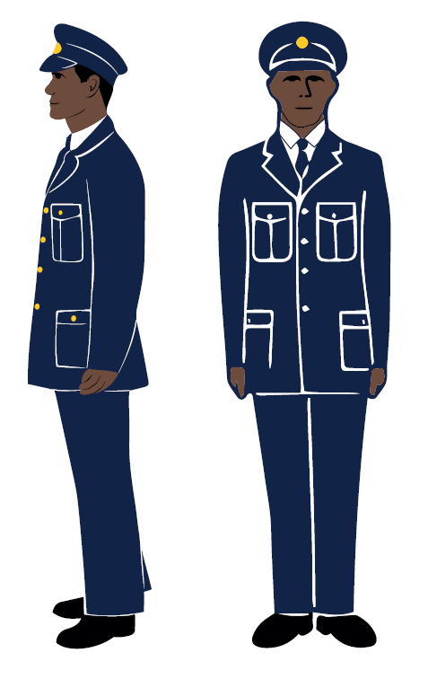
Formation of squad
Position of attention
On the command “SQUAD-TION”, (Pronounce “squad shun”), the left foot is moved to the right foot resulting in both heels together and in line; feet turned out at an angle of about 45 degrees; body erect; head up, shoulders level and square to the front. Breathing should not in any way be restricted.

Slide 74

Formation of Squad – Squad Numbering and Falling In
No. 1
No. 2
No. 3
No. 4
No. 5
Squad!
Squad-tion!

Slide 75
Formation of Squad – Squad Numbering and Falling In
No. 1
No. 2
No. 3
No. 4
No. 5
“1”
“2”
“3”
“4”
“5”
From the right number!

Slide 76
Formation of Squad – Squad Numbering and Falling In
No. 1
No. 2
No. 3
No. 4
No. 5
“1”
“2”
“3”
“4”
“1”
In crews of 4, number!

Slide 77
Formation of Squad – Squad Numbering and Falling In
No. 1
No. 2
No. 3
No. 4
No. 5
“1”
“2”
Crews number!

Slide 78
Formation of Squad – Squad Numbering and Falling In
No. 1
No. 2
No. 3
No. 4
No. 5
Number 2 crew, stand at ease. Number 1 crew, fall in 3 paces to the rear of and facing the equipment, crew fall in!

Slide 79
Formation of Squad – Squad Numbering and Falling In
No. 2 – steps back and joins the end of the crew
No. 4
No. 3
No. 1

Slide 80

Formation of Squad – Squad Numbering and Falling In
No. 2
No. 4
No. 3
No. 1

Slide 81
Section 7
Participating in and supervising YH1-4 and YL1-3 standard drills

Slide 82
Crew assembled
Make sure the crew has been briefed and is standing at the back of the equipment or appliance – follow previous slides on squad formation
Crew should be standing to attention
Explain the drill clearly (following Standard Practices):
  What the whole drill will include
  What each person needs to do
  What to do when packing away (Make up)
Check that everyone understands
Ask if anyone has any questions
Check if crew are fit and well
Begin drill – “As far as detailed, get to work!”

Slide 83
Example YH1
Explain the drill clearly:
What the whole drill will include
What each person needs to do
What to do when packing away (Make up)
  The drill will be to provide a single line of hose consisting of three lengths from the hydrant
  On the command get to work no.2 ships the hydrant, no.4 runs out the first length, no.3 runs out the 2nd length, no.1 will take a branch and the 3rd length.
  On making up, no.1 will return the branch to the start, no.2 will make up the hydrant, no.3, 4 and 1 will make up the hose as necessary
  Ask if everyone understands the drill
  Ask if they have any questions
  Check if crew are fit and well
  “As far as detailed, get to work!”

Slide 84
Supervising drills - Practice
Candidates should now practice supervision of drills YH1-4 or YL1-3 and be provided with feedback prior to assessment.
Standard Practice Drills YH1-4 and YL1-3 are fully detailed within NFCC Youth Drill Ground Training and Development Manual:
Youth_Drill_Ground_Training_and_Development.pdf
YH1 – pages 70 to 74
YH2 – page 75
YH3 – page 76
YH4 – pages 77 and 78
YL1 – pages 130 to 132
YL2 – pages 133 and 134
YL3 – pages 135 to 137
Notes:
Candidates to be observed in line Drill Ground Supervision Assessment and provided with appropriate feedback prior to formally being assessed.

Slide 85
Supervising drills - Practical
Candidates should now demonstrate supervision of a drill and be assessed using the marking criteria.
Drills YH1-4 or YL1-3 can be used for assessment purposes.
Notes:
Candidates to be assessed in line Drill Ground Supervision Assessment and marked as:
Above required standard
Met required standard
Below required standard

